Slide 1

磁共振影像系統
作業二
老師：黃騰毅
學生：M11302208陳宥余

Slide 2
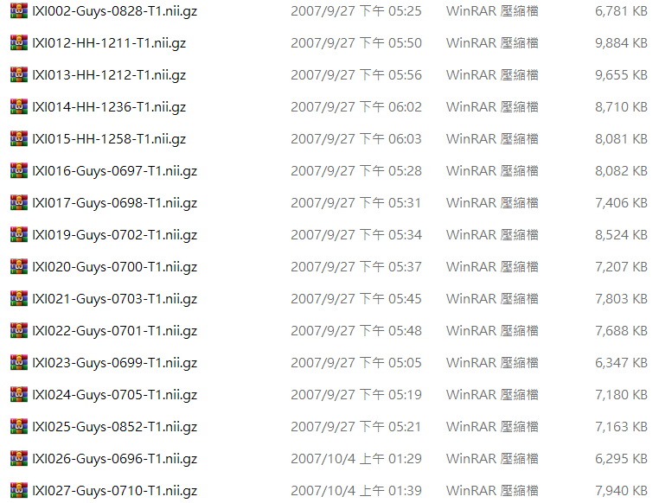
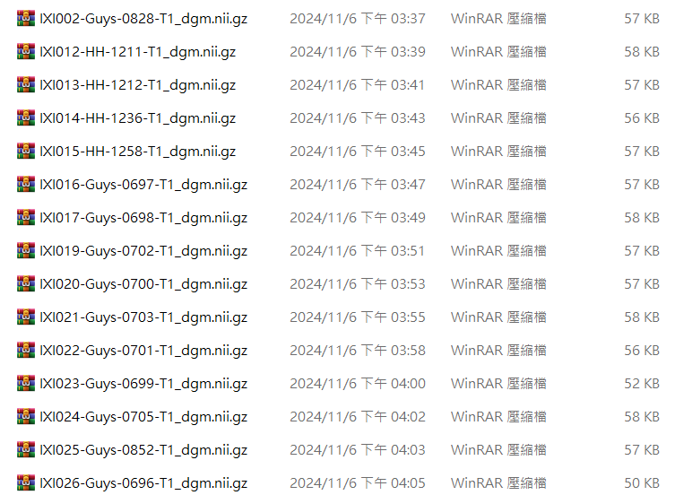
(1) Please use the TigerBx software to perform brain segmentation.

Slide 3
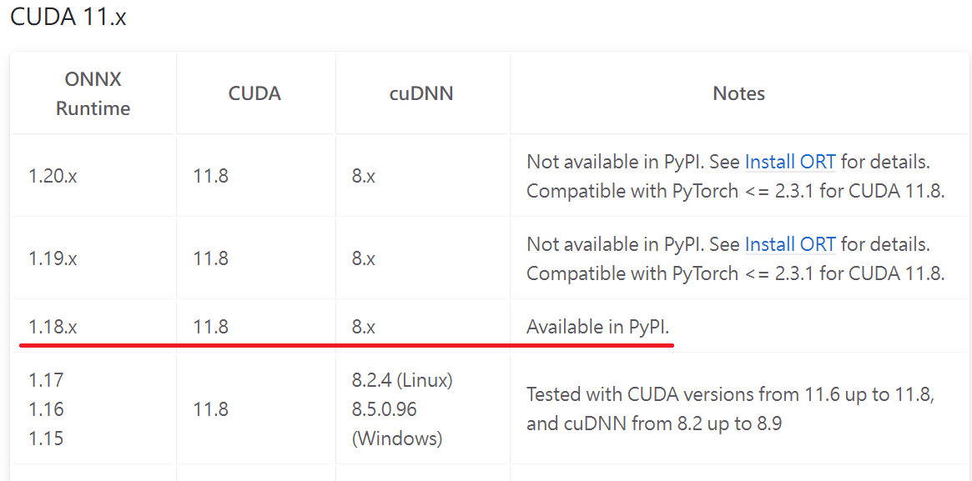
(1) Please use the TigerBx software to perform brain segmentation.
onnxruntime-gpu v1.18.0+cuda11.8+cuDNN v8.9.7 withGTX1060

Slide 4
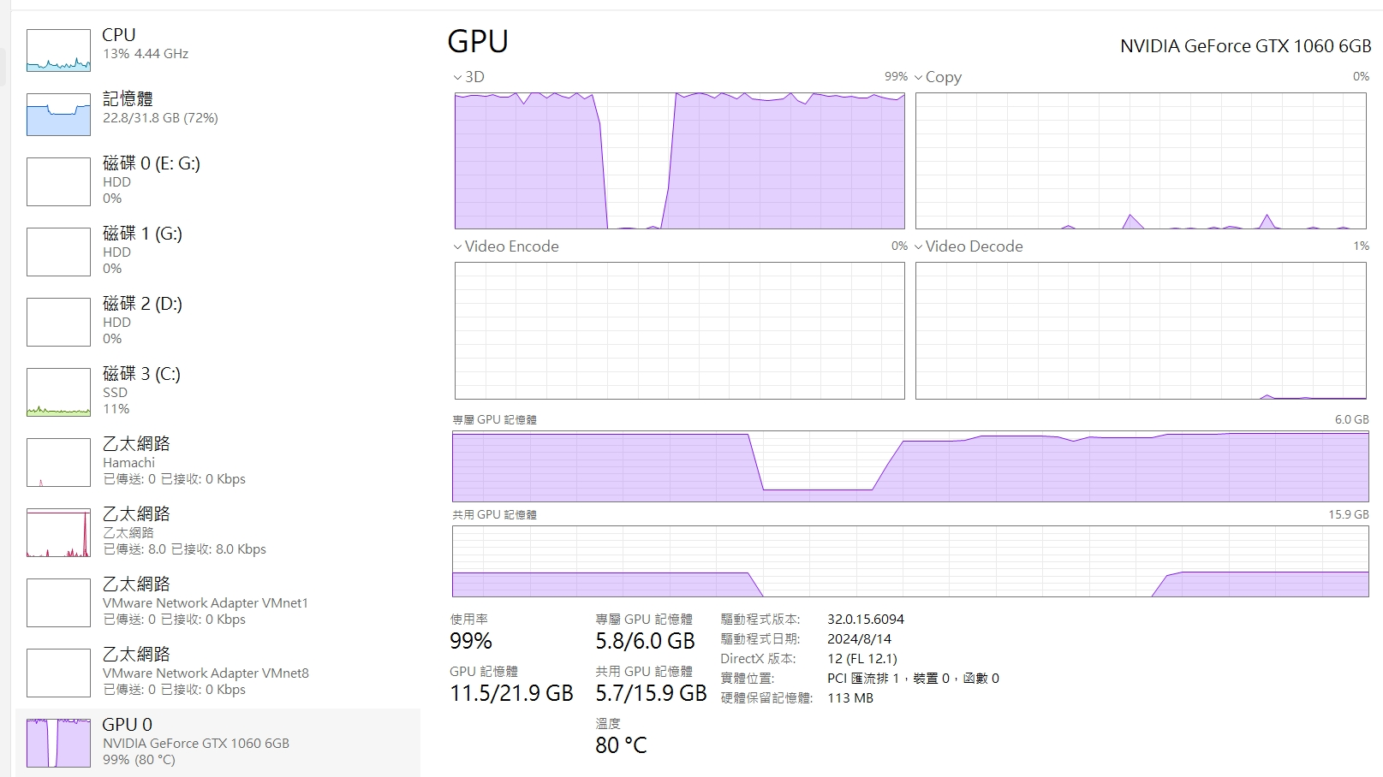
(1) Please use the TigerBx software to perform brain segmentation.
onnxruntime-gpu v1.18.0+cuda11.8+cuDNN v8.9.7 withGTX1060

Slide 5
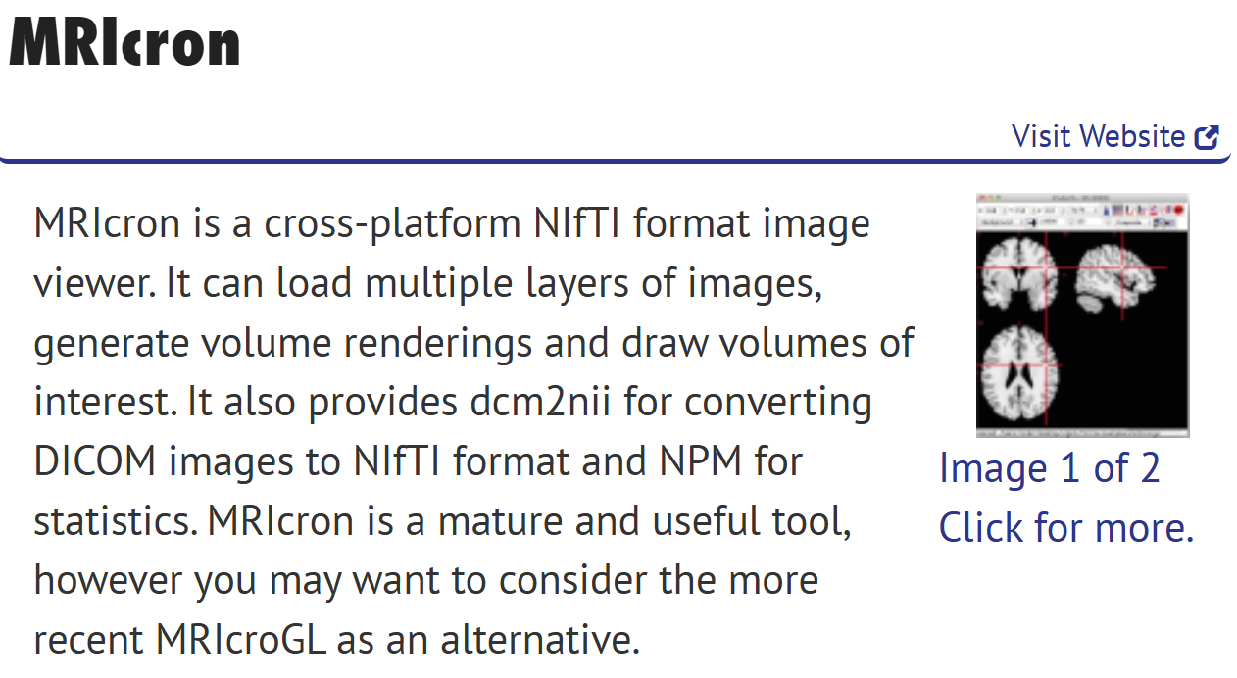
(1) Please use the TigerBx software to perform brain segmentation.

Slide 6
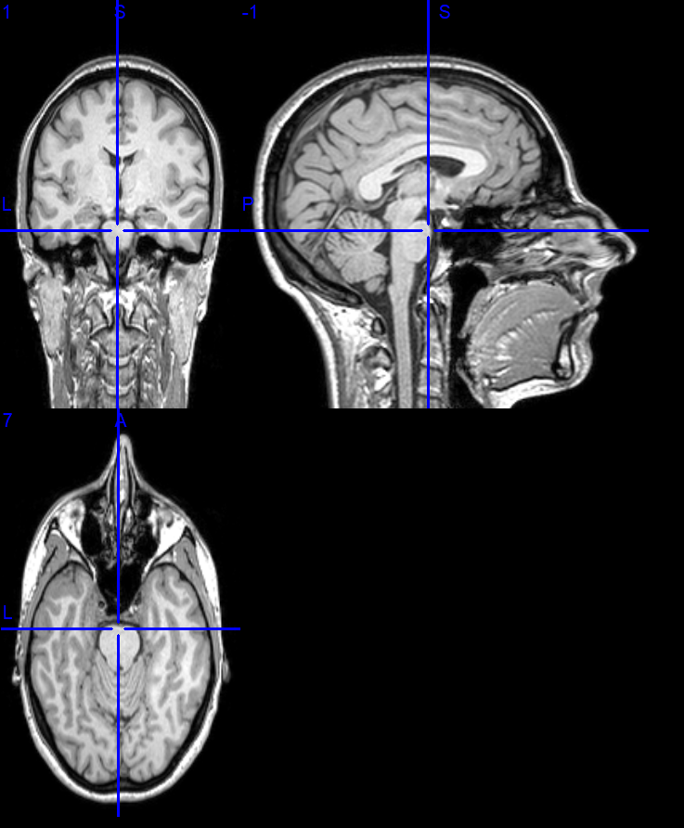
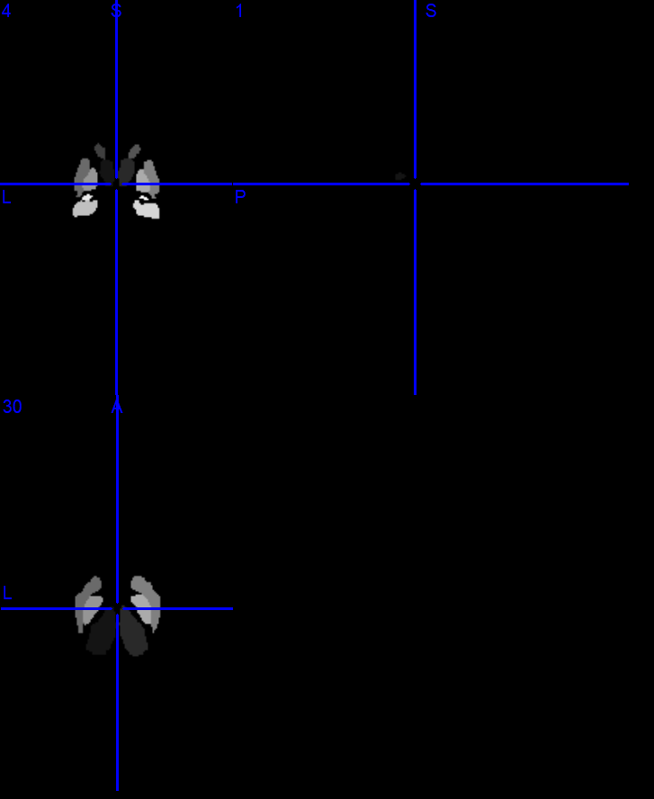
(1) Please use the TigerBx software to perform brain segmentation.

Slide 7
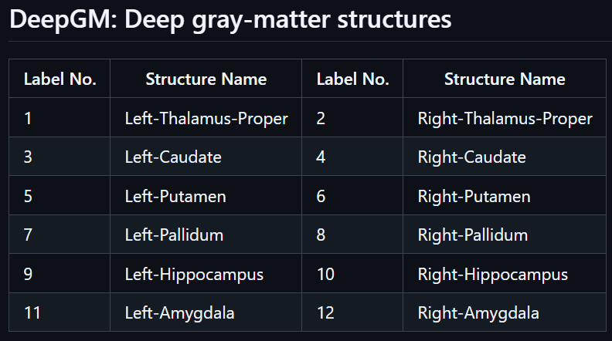
(1) Please use the TigerBx software to perform brain segmentation.

Slide 8
(2) Calculate the volumes of the subcortical regions of the brain for these subjects.
1. Define
brain region labels
2. Set
file folder path
3. Create
results table
4. Read
each NIfTI file
5. Calculate
Voxel count
6. Calculate
Voxel volume
7. Calculate
Voxel count * volume for each region
8. Export as Excel file

Slide 9
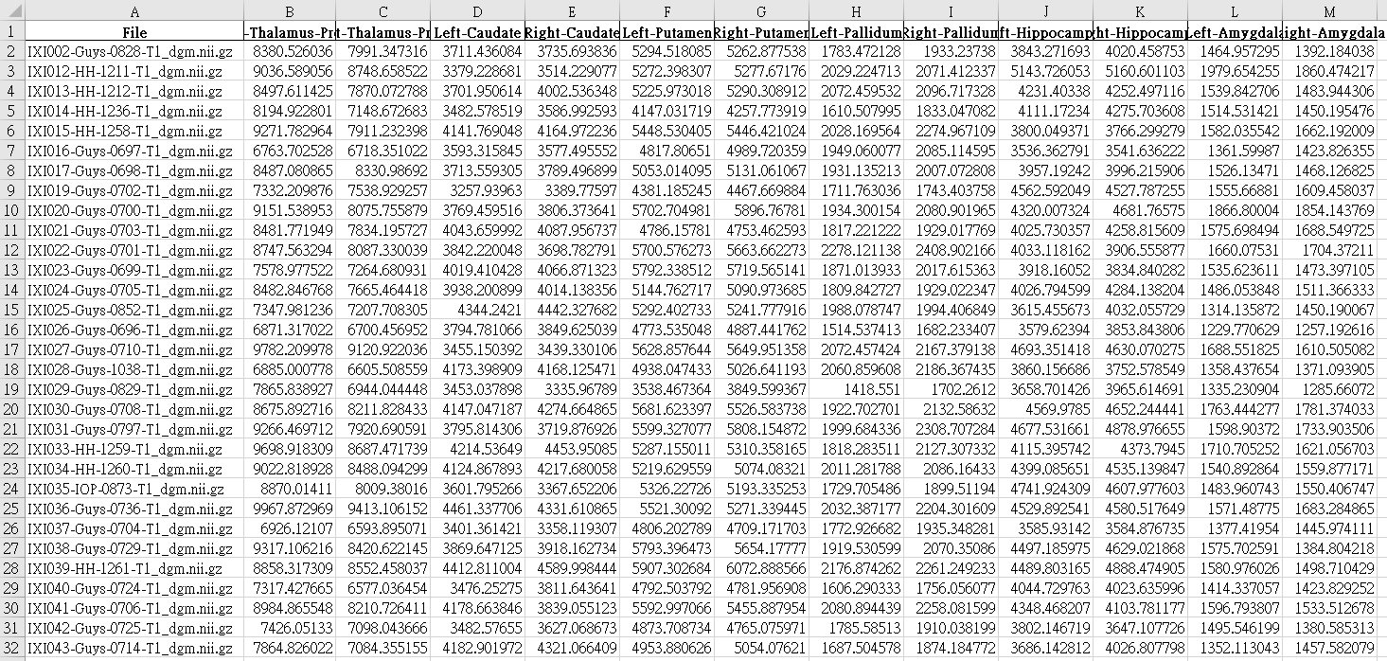
(2) Calculate the volumes of the subcortical regions of the brain for these subjects.

Slide 10
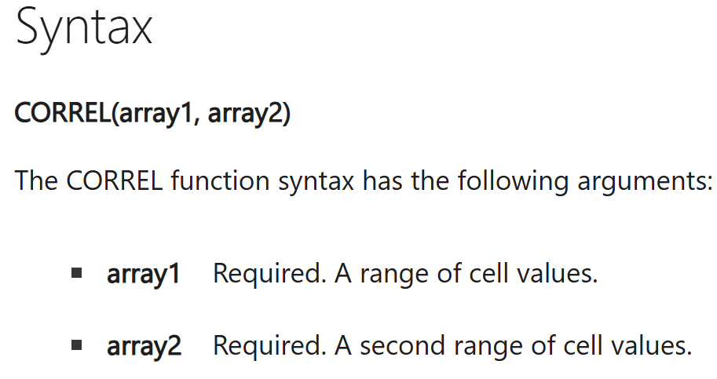
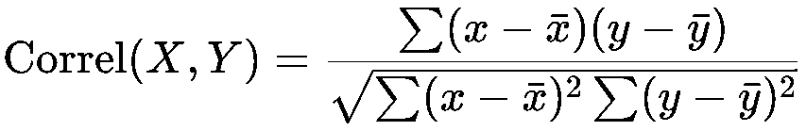
(3) Based on the demographic information provided by the original website, try to explore the correlation between the volumes of various subcortical regions and the subjects' information. For example, is there a correlation between the hippocampus or thalamus and the age of the subjects?
Pearson Correlation Coefficient

Slide 11
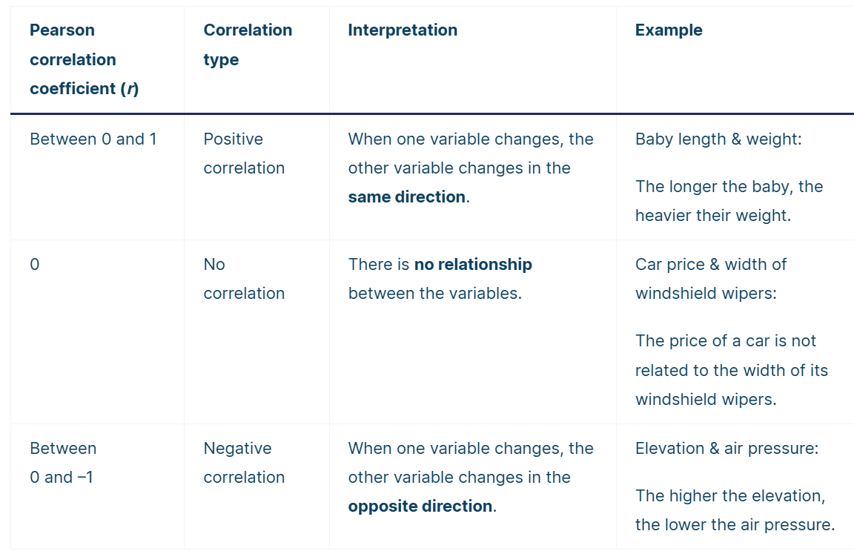
(3) Based on the demographic information provided by the original website, try to explore the correlation between the volumes of various subcortical regions and the subjects' information. For example, is there a correlation between the hippocampus or thalamus and the age of the subjects?
Pearson Correlation Coefficient

Slide 12
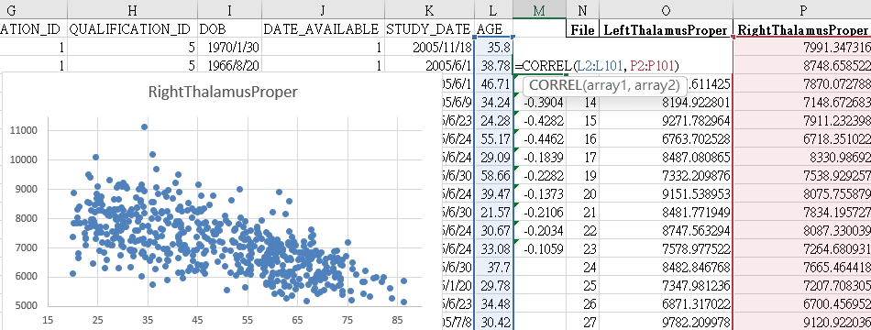
(3) Based on the demographic information provided by the original website, try to explore the correlation between the volumes of various subcortical regions and the subjects' information. For example, is there a correlation between the hippocampus or thalamus and the age of the subjects?

Slide 13
(3) Based on the demographic information provided by the original website, try to explore the correlation between the volumes of various subcortical regions and the subjects' information. For example, is there a correlation between the hippocampus or thalamus and the age of the subjects?

Slide 14
(3) Based on the demographic information provided by the original website, try to explore the correlation between the volumes of various subcortical regions and the subjects' information. For example, is there a correlation between the hippocampus or thalamus and the age of the subjects?

Slide 15
(3) Based on the demographic information provided by the original website, try to explore the correlation between the volumes of various subcortical regions and the subjects' information. For example, is there a correlation between the hippocampus or thalamus and the age of the subjects?

Slide 16
(3) Based on the demographic information provided by the original website, try to explore the correlation between the volumes of various subcortical regions and the subjects' information. For example, is there a correlation between the hippocampus or thalamus and the age of the subjects?

